Slide 1
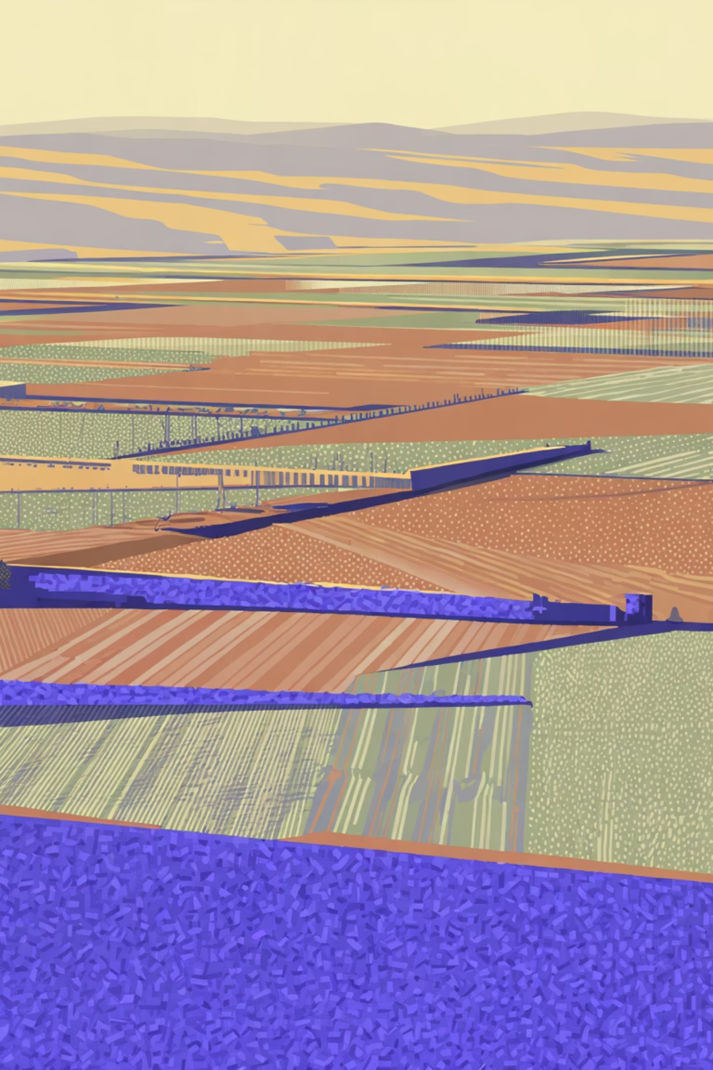
We're not building an app. We're building the agricultural intelligence layer for North Africa.
Starting where the need is greatest — in the language no one else speaks, in the places no one else reaches.
WAFRA · وافرة

Slide 2
Year 1 · Establish
Year 3 · Scale
🇩🇿 Algeria
🌍 Region
10,000 users
500 Pro subscribers
5–10 cooperative contracts
Ministry of Agriculture MOU
$21K ARR
400,000 users
20,000 Pro subscribers
6 countries
National disease surveillance platform
Series A $3–5M target
$1.2M ARR
Year 2 · Grow
🇹🇳 🇲🇦 MENA
80,000 users
4,000 Pro subscribers
Seed funding round
Telecom data bundle live
$200K ARR
"Every time a farmer scans a leaf, Wafra learns. The more farmers use it, the smarter it gets. The smarter it gets, the more farmers trust it. Darija + offline + community data = a moat no competitor can buy."
Wafra. وافرة. Abundance — for every farmer who deserves a better harvest.

